Slide 1

Predict PM_{2.5} in Five Chinese Cities: A Comparison Between Bayesian Hierarchical Model And LSTM Network
Mengjie Zhang
Data Science Capstone
George Washington University

Slide 2
INTRODUCTION
PM_{2.5}
Airborne particulate matter with diameter less than 2.5 microns.
Cause adverse health effect, especially respiratory system.
Sources include vehicle exhausts, fuel burning, power plants, wildfires etc.
http://berkeleyearth.org/air-pollution-overview/

Slide 3

DATASET
The dataset is downloaded from UCI Machine Learning Repository (http://archive.ics.uci.edu/ml/datasets/PM2.5+Data+of+Five+Chinese+Cities).
Includes five cities: Beijing, Chengdu, Guangzhou, Shanghai, Shengyang from 2011 to 2015.
The dataset includes:
Time of records(year, month, day, hour, season) .
Air PM_{2.5} concentration recorded hourly.
Meteorological parameters (dew point, temperature, humidity, pressure, wind direction, wind speed, hourly precipitation and cumulated precipitation).

Slide 4
Goal
Air PM 2.5 concentration is dependent on many factors:
Sources (vehicle exhausts, coal burning, power plants, wildfires etc.)
Transport process (wind, temperature, pressure, precipitation etc.)
Predict PM 2.5 from historical records and meteorological parameters using two different approaches: Bayesian model vs. LSTM network.

Slide 5
METHODS
Bayesian Model
Data Preprocessing (log transform).
Bayesian Linear Model:
LSTM Network
Data Preprocessing (keep categorical feature and label encoding, normalization/scaling, train/test split)
Build LSTM network (Keras)
Model prediction (calculate RMSE)
Bayesian Hierarchical Model : Feature selection by model comparison (only numerical features)
$ε\left(t\right)\sim N(0, σ^{2}$)
𝜀(𝑡)~ 𝑁(0, 𝜎^2)
$$Y\left(t\right)= β0+ β1X1+ β2X2+ …+ βnY\left(t−1\right)+ ε(t)$$
𝑌(𝑡)= 𝛽0+ 𝛽1𝑋1+ 𝛽2𝑋2+ …+ 𝛽𝑛𝑌(𝑡−1)+ 𝜖(𝑡)

Slide 6
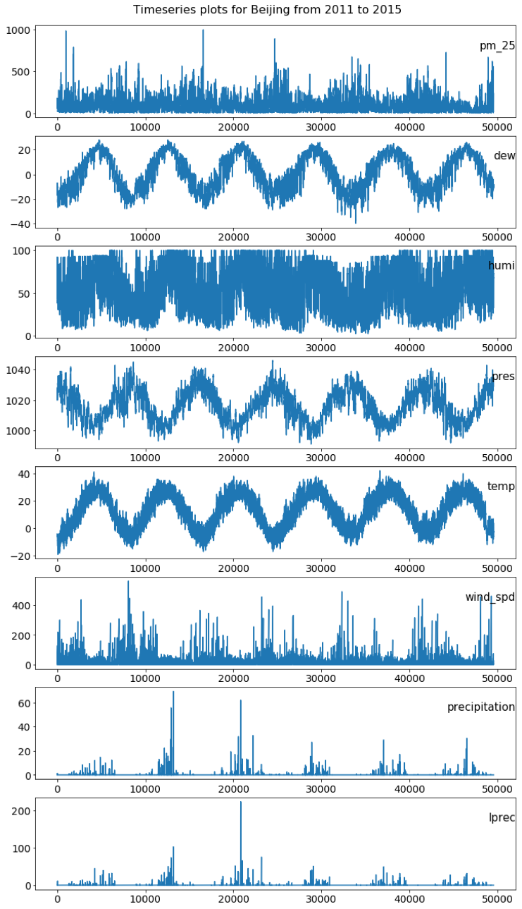
Data overview: Timeseries trend

Slide 7
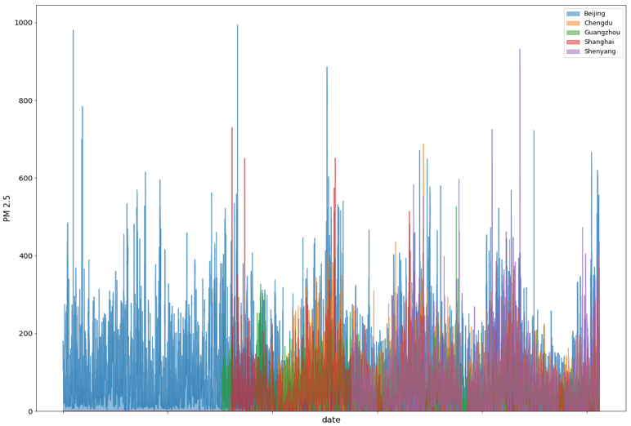
Time-series of PM 2.5 in five cities
https://mengjiez99.github.io/my-capstone-project/

Slide 8
Exploratory Data Analysis

Slide 9
Exploratory Data Analysis

Slide 10
Exploratory Data Analysis

Slide 11
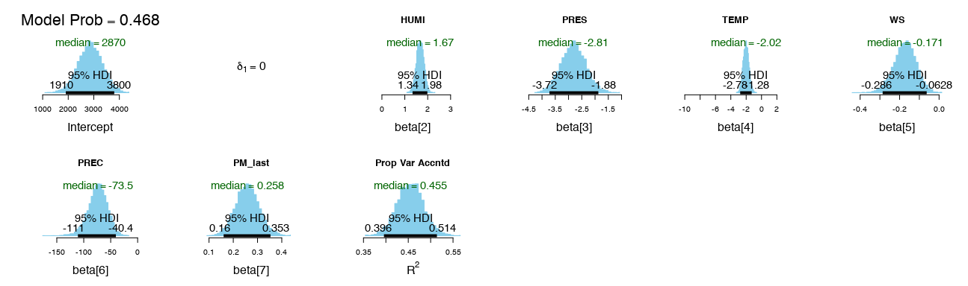
Model: Bayesian hierarchical model
Variable Selection
The model that included 6 predictors (HUMI, PRES, TEMP, PREC, PM_last) has shown largest posterior model probability (0.468).

Slide 12
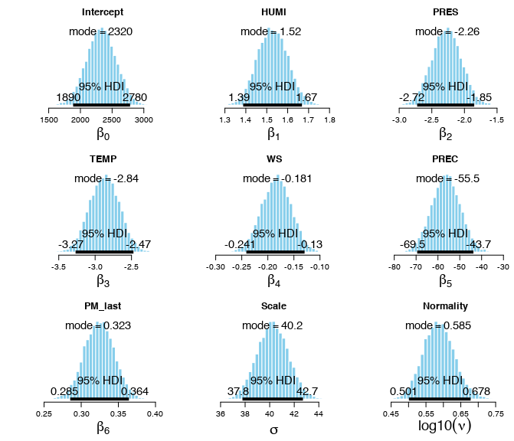
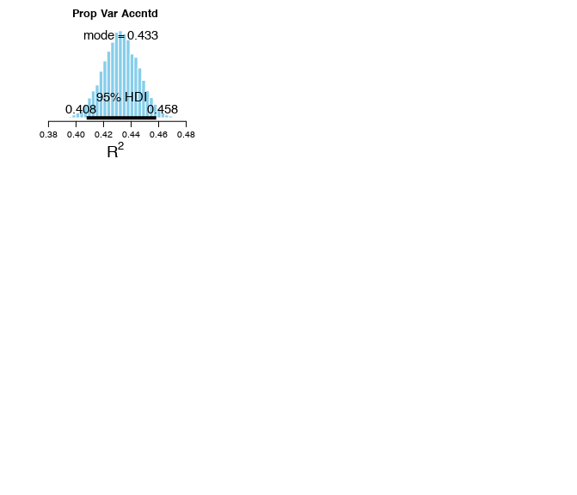
Model: Bayesian linear model
Notes:
Then I built a BLM using the 6 predictors selected, the figure here shows the posterior distribution of the coefficient associated with each feature.
The model explains the relationship with each predictor, e.g. with 1 degree of temperature increase, the log pm2.5 is expected to decrease by 2.5 to 3.3.
The R2 indicates that the model explained 43% proportion of total variance with a HDI from 0.4 to 0.46.

Slide 13
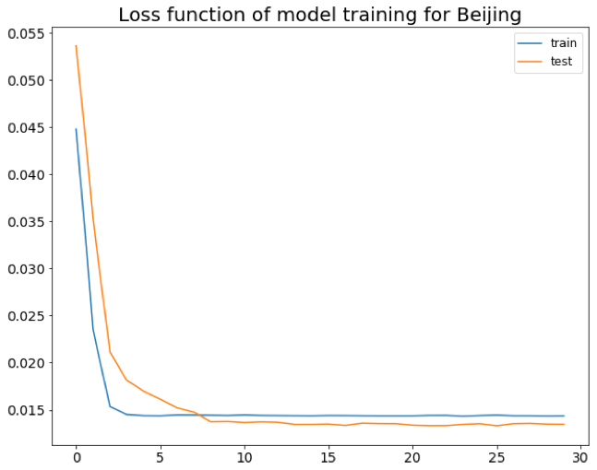
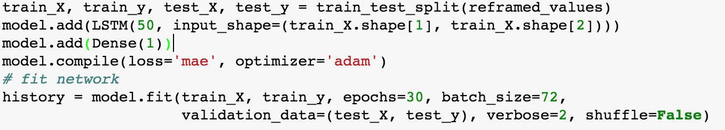
Model: LSTM Network
Notes:
I build the LSTM network using Keras in python
The network has 1 LSTM layer of 50 neurons and model is trained for 30 epochs.
The history plot of loss function shows that the model converged well after 30 epochs of training for both training and test dataset.
The loss function (mean absolute error) dropped from 0.055 to 0.015.

Slide 14
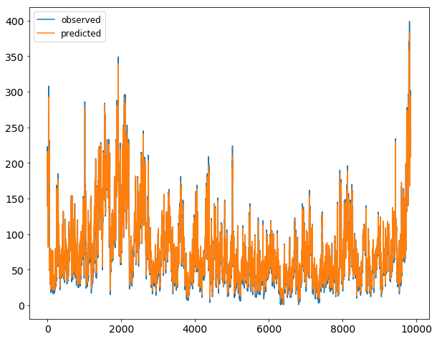
Model: LSTM Prediction
https://mengjiez99.github.io/my-capstone-project/

Slide 15
CONCLUSION
The Bayesian approaches have selected 6 variables (humidity, temperature, pressure, wind speed, precipitation, last hour pm 2.5) by Bayesian hierarchical model comparison.
The LSTM network has outperformed the Bayesian linear model according to RMSE calculated from model prediction.
RMSE Model | Beijing | Chengdu | Shanghai | Guangzhou | Shenyang
Bayesian | 61.39 | 50.21 | 42.90 | 48.36 | 59.32
LSTM | 23.49 | 12.77 | 10.86 | 11.82 | 21.07

Slide 16

Prospects
LSTM for multi-step timeseries prediction
Find a universal model for cities/regions that share similar pollution and weather scenarios.

